Slide 1

Am I responsive? Test me!
Galen framework

Slide 2


About me
Fernando Martín
Senior QA Engineer
Tech lover
Quasi-blogger
http://bit.ly/fer-mg

Slide 3

What am I showing today?

Slide 4

Responsive Web Design
Notes:
Different screen size and element appearance for devices
Google is penalizing websites that aren’t responsive.

Slide 5
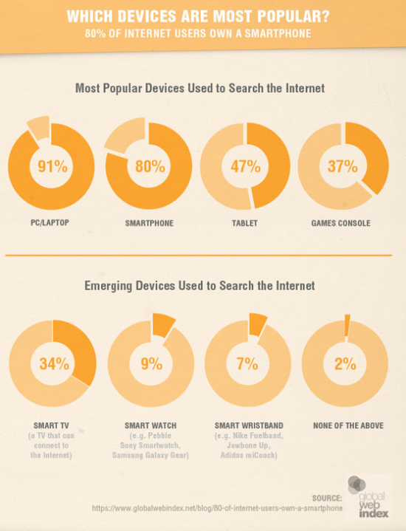

Slide 6


Slide 7

Galen comes to the rescue!

Slide 8

What’s Galen?

Slide 9

What’s Galen?
Human readable
Syntax
Basic
Advanced
Reports
JS and Java APIs
Selenium integration

Slide 10
Installation
Download
http://galenframework.com/download/
Last release: 2.2.5
Extract
Install
Linux/OS X: sudo ./install.sh
Windows: galen.bat

Slide 11

Galen Spec Language
Object definition
Galen spec language
@objects search-panel id search-bar search-panel-button css #search-bar a menu-item-* css #menu li a
HTML
<body> <div id='search-bar'> <input type='text' name='search' value=''/> <a href='#' class='search-button'>Search</a> </div> <ul id='menu'> <li><a href='#'>Home</a></li> <li><a href='#'>Blog</a></li> </ul> </body>

Slide 12
Galen Spec Language
Object specs
near
below
above
left-of, right-of
inside
width
height
aligned
text
visible
centered
absent
contains
on
component
Frame support
count
color-scheme
Image

Slide 13
Galen Spec Language
Advanced object specs
Importing
Same spec to multiple objects
If statements
Loops
Warning level
Custom rules
Custom functions
Galen Spec JS API

Slide 14
Galen Spec Language
Ranges
width 100px
width 50 to 200 px
width > 40 px
width < 40 px
width ~ 100 px
width 30 to 100 % of screen/width

Slide 15
Galen Spec Language
Variables
@set headerMargin 10 to 20px = Header = header-icon: inside header ${headerMargin} top left

Slide 16
Galen Spec Language
Tagging and sections
= Main section = @on * menu: height 300 px @on desktop login-button: height 40 px

Slide 17
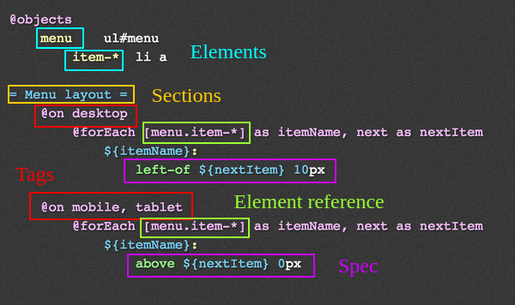
Galen Spec Language

Slide 18
Running tests
Single page test
→ args:
url
javascript
include/exclude
size
htmlreport
testngreport
jsonreport
$ galen check specFile [args]

Slide 19
Running tests
Example
$ galen check homepage.spec --url “http://example.com” --size “640x480” --include “mobile” --exclude “desktop” --htmlreport “htmlreport-dir”

Slide 20
Running tests
Test suite
→ args:
htmlreport
testngreport
parallel-tests
recursive
filter
$ galen test testSuite [args]

Slide 21
Running tests
Example
$ galen test mytest01.test --testngreport "report/testng.xml" --parallel-tests 2

Slide 22
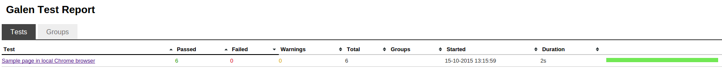
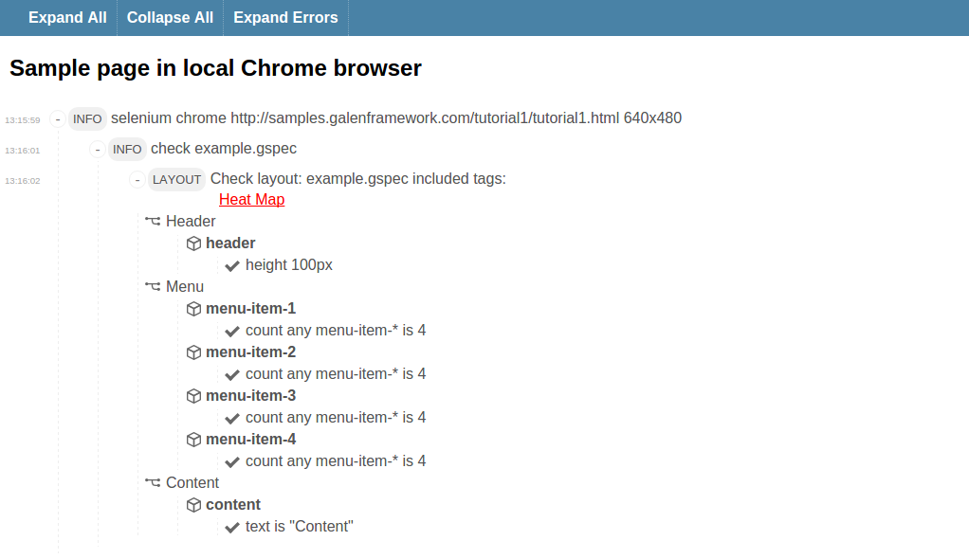
Reports

Slide 23
Resources
Official website: http://galenframework.com/
Github: https://github.com/galenframework
More examples: http://mindengine.net/category/galen/

Slide 24

Let’s code it!

Slide 25




Thank you!
Questions?
Fernando Martín
efemgy@gmail.com
fer3MG
https://github.com/fernando-martin
http://bit.ly/expoqa-galen

